Slide 1
ES6 Features

Slide 2
let, const keywords.
Before ES6 , JavaScript had only two types of scope: Global Scope and Function Scope.
ES2015 introduced two important new JavaScript keywords: let and const.These two keywords provide Block Scope variables (and constants) in JavaScript.
Let Keyword
The let statement declares a block-scoped local variable, optionally initializing it to a value.
Syntax :
var1,var2,…,varN – The names of the variable or variables to declare. Each must be a legal JavaScript identifier.
value1,value2,..valueN : Optional
Let var1 [=value1] [,var2 [=value2] ] [, …, varN [= valueN];

Slide 3
Let Keyword
Example
let x = 1;
if (x === 1) {
let x = 2;
console.log(x);
// expected output: 2
}
console.log(x);
// expected output: 1
Function letTest() {
let x = 2;
{
let x = 3; // different variable
console.log(x);
// expected output: 3
}
console.log(x);
// expected output: 2
}

Slide 4
let, const keywords
Const Keyword
Constants are block-scoped, much like variables defined using the let keyword . The value of a constant can't be changed through reassignment, and it can't be redeclared.
Syntax :
nameN : The constant’s name , which can be any legal identifier.
valueN : The constant’s value.This can be any legal expression, including a function expression.
const name1 = value1 [,name2 = value2 [ , … [ , nameN = valueN]]];

Slide 5
const Keyword
Example
const x = 1;
if (x === 1) {
const x = 2;
console.log(x);
// expected output: 2
}
console.log(x);
// expected output: 1
Function constTest() {
const x = 2;
{
const x = 3; // different variable
console.log(x);
// expected output: 3
}
console.log(x);
// expected output: 2
}

Slide 6
Arrow functions.
Arrow Function :
Arrow functions allow us to write shorter function syntax:
syntax :
( args ) => {
//statements
}
Template String(``) :
It lets us insert/interpolate variables and expressions into strings without needing to concatenate like in older versions of JavaScript.
Syntax :
`string text ${expression} string text`

Slide 7
Default Parameters
Default function parameters allow named parameters to be initialized with default values if no value or undefined is passed .
function multiply(a, b = 1) {
return a * b;
}
console.log(multiply(5, 2));
// expected output: 10
console.log(multiply(5));
// expected output: 5

Slide 8
…spread & …rest operators
The spread operator “spreads” the values in an iterable (arrays, strings) across zero or more arguments or elements.
Example
var arr1 = [1 ,2 ,3 ,4 ,5]
var arr2 = [ …arr1 , 6, 7, 8, 9] // [1 ,2 ,3 ,4 ,5 ,6 ,7 ,8 ,9]
The rest parameter gives us an easier and cleaner way of working with an indefinite number of parameters.
Example
function test(…args) {
// here args it self is array of parameters
for( let arg in args){
console.log(arg)
}
}

Slide 9
Object De-structuring
The object destructuring is a useful JavaScript feature to extract properties from objects and bind them to variables.
Syntax
const { identifier1:[aliasIdentifier], identifier2, ..., identifierN } = expression;
Example :
const hero = {
name: 'Batman',
realName: 'Bruce Wayne‘
};
const { name, realName:fullname } = hero;
name; // => 'Batman',
realfullname; // => 'Bruce Wayne'

Slide 10
Array De-structuring.
The Array de-structuring is a useful JavaScript feature to extract array elements from Array and bind them to variables.
Syntax
var [ identifier1 ,identifier2, ..., identifier} = Array/ [element1 , element2 …];
Example :
var array = [‘HTML’ , ‘CSS’,’JS’ ]
const { first, second , third } = array;
first // => ‘HTML’,
third // => ‘ JS'

Slide 11
Promises
Promises are used to handle asynchronous operations in JavaScript.
Syntax
var Promise = new Promise(function (resolve, reject){
//do something
}
Promise.then( function( result) {
// handle success
}).catch(function(error) {
// handle error
}).
There are 3 states of the Promise object:
Pending: Initial State, before the Promise succeeds or fails
Resolved: Completed Promise
Rejected: Failed Promise

Slide 12
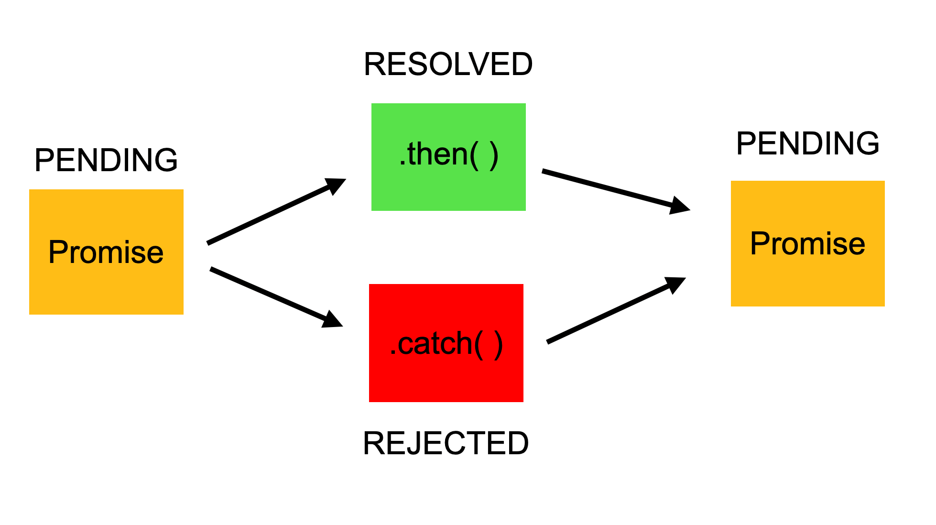
Promises

Slide 13
Promise Chaining
Promises chaining can be used when we have a sequence of asynchronous tasks to be done one after another. Promises are chained when a promise depends on the result of another promise.
function add_positivenos_async(n1, n2) {
let p = new Promise(function (resolve, reject) {
if (n1 >= 0 && n2 >= 0) {
resolve(n1 + n2)
} else {
reject('NOT_Postive_Number_Passed');
})
return p;
}

Slide 14
add_positivenos_async(10,20)
.then(function(result){
console.log("first result“ ,result)
return add_positivenos_async(result ,result)
}).then(function(result){
console.log("second result“ ,result)
return add_positivenos_async(result ,result)
}).then(function(result){
console.log("third result“ ,result)
})
Output :
first result 30 second result 60 third result 120

Slide 15
Promise Race
The Promise.race() method returns a promise that fulfills or rejects as soon as one of the promises in an iterable fulfills or rejects, with the value or reason from that promise.
const promise1 = new Promise((resolve, reject) => { setTimeout(resolve, 500, 'one');
});
const promise2 = new Promise((resolve, reject) => { setTimeout(resolve, 100, 'two');
});
Promise.race([promise1, promise2]).then( (value) => { console.log(value);
// Both resolve, but promise2 is faster
});

Slide 16
Async/await
So, async ensures that the function returns a promise, and wraps non-promises in it.
There’s another keyword, await, that works only inside async functions, and it’s pretty cool.
Await
The syntax:
// works only inside async functions
let value = await promise;
The keyword await makes JavaScript wait until that promise settles and returns its result.
Note : Can’t use await in regular functions
If we try to use await in non-async function, there would be a syntax error:

Slide 17
Async/await
async function f() {
let promise = new Promise((resolve, reject) => {
setTimeout(() => resolve("done!"), 1000)
});
let result = await promise; // wait until the promise resolves (*)
alert(result); // "done!"
}
f();
The function execution “pauses” at the line (*) and resumes when the promise settles, with result becoming its result. So the code above shows “done!” in one second.

Slide 18
Class
A class is a type of function, but instead of using the keyword function to initiate it, we use the keyword class, and the properties are assigned inside a constructor() method.
Class Definition :
Use the keyword class to create a class, and always add the constructor() method.
The constructor method is called each time the class object is initialized.
Syntax :
class class_name{
constructor(){
//properties declaration and initialization
} //end of constructor
} //end of class

Slide 19
Class
Methods
The constructor method is special, it is where you initialize properties, it is called automatically when a class is initiated, and it has to have the exact name "constructor", in fact, if you do not have a constructor method, JavaScript will add an invisible and empty constructor method.
Example
class Car { constructor(brand) { this.carname = brand; }
present() { return "I have a " + this.carname; }
}
var mycar = new Car("Ford"); //Object Creation
console.log(mycar.carname); // accessing the data member
console.log(mycar.present()); //accessing the method

Slide 20
Class
What is this?
The JavaScript this keyword refers to the object it belongs to.
It has different values depending on where it is used:
In a method, this refers to the owner object.
Alone, this refers to the global object.
In a function, this refers to the global object.
In an event, this refers to the element that received the event.

Slide 21
class
Static Methods
Static methods are defined on the class itself, and not on the prototype.
That means you cannot call a static method on the object ,but on the classname
class Car { constructor(brand) { this.carname = brand; }
static hello() { return "Hello!!"; } }
mycar = new Car("Ford"); //Call 'hello()' on the class Car: document.getElementById("demo").innerHTML = Car.hello();

Slide 22
Class - Inheritance
To create a class inheritance, use the extends keyword.
A class created with a class inheritance inherits all the methods from another class.
class Model extends Car { constructor(brand, mod) { super(brand); this.model = mod; } show() { return this.present() + ', it is a ' + this.model; } } mycar = new Model("Ford", "Mustang");
document.getElementById("demo").innerHTML = mycar.show();

Slide 23
Class
The super() method refers to the parent class.
By calling the super() method in the constructor method, we call the parent's constructor method and gets access to the parent's properties and methods.
Inheritance is useful for code reusability: reuse properties and methods of an existing class when you create a new class.
Getters and Setters
It can be smart to use getters and setters for your properties, especially if you want to do something special with the value before returning them, or before you set them.
To add getters and setters in the class, use the get and set keywords
Note: even if the getter is a method, you do not use parentheses when you want to get the property value.

Slide 24
Class
class Car { constructor(brand) { this.carname = brand; }
get cnam() { return this.carname; }
set cnam(x) { this.carname = x; } } mycar = new Car("Ford"); document.getElementById("demo").innerHTML = mycar.cnam;

Slide 25
Modules
Consider a scenario where parts of JavaScript code need to be reused. ES6 comes to your rescue with the concept of Modules.
A module can contain variables and functions.
A module is nothing more than a chunk of JavaScript code written in a file. By default, variables and functions of a module are not available for use.
Variables and functions within a module should be exported so that they can be accessed from within other files.
Modules in ES6 work only in strict mode. This means variables or functions declared in a module will not be accessible globally.

Slide 26
Modules - Export
Exporting a Module
The export keyword can be used to export components in a module.
Exports in a module can be classified as follows −
1) Named Exports
2) Default Exports
Named Exports
Named exports are distinguished by their names. There can be several named exports in a module.
A module can export selected components using the syntax given below −
Syntax – 1
//using multiple export keyword
export component1
export component2 ... ...
export componentN

Slide 27
Modules - Export
Syntax – 2
//using single export keyword
export {component1,component2,....,componentN}
Default Exports
Modules that need to export only a single value can use default exports.
There can be only one default export per module.
Syntax -
export default component_name

Slide 28
Modules - Import
Importing a Module
To be able to consume a module, use the import keyword.
A module can have multiple import statements.
Importing Named Exports
While importing named exports, the names of the corresponding components must match.
Syntax -
import {component1,component2..componentN} from module_name
while importing named exports, they can be renamed using the as keyword. Use the syntax given below −
import {original_component_name as new_component_name }

Slide 29
Modules - Import
All named exports can be imported onto an object by using the asterisk * operator.
import * as variable_name from module_name
Importing Default Exports
Unlike named exports, a default export can be imported with any name.
Syntax
import any_variable_name from module_name

Slide 30
Babel
Babel is a JavaScript compiler.
Babel is a toolchain that is mainly used to convert ECMAScript 2015+ code into a backwards compatible version of JavaScript in current and older browsers or environments. Here are the main things Babel can do for you:
a) Transform syntax
b) Source code transformations (codemods) And more!
Babel has support for the latest version of JavaScript through syntax transformers.
// Babel Input: ES2015 arrow function
[1, 2, 3].map((n) => n + 1);
// Babel Output: ES5 equivalent
[1, 2, 3].map(function(n) { return n + 1; });

